Slide 1
Citi Bike Analytics
An analysis for the New York Citi Bike Program, in which responsible for overseeing the largest bike sharing program for 200,000+ data points in the United States in order to generate business insights in terms of visualize the peak time in both summer and winter period and the top start location in New York City and Jersey City, New Jersey.

Slide 2


Slide 3
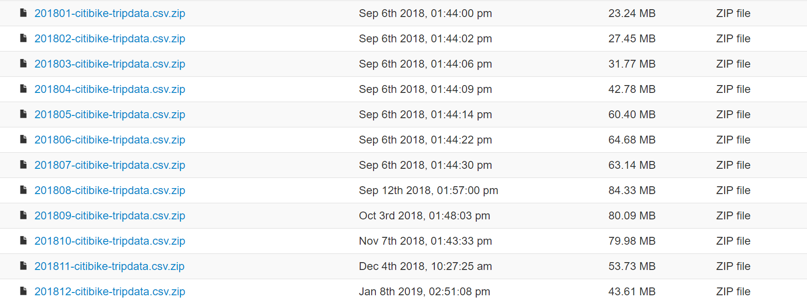
About The Data
This Citi Bike Data has been processed to remove trips that are taken by staff as they service and inspect the system and any trips that were below 60 seconds in length (potentially false starts or users trying to re-dock a bike to ensure it's secure).

Slide 4
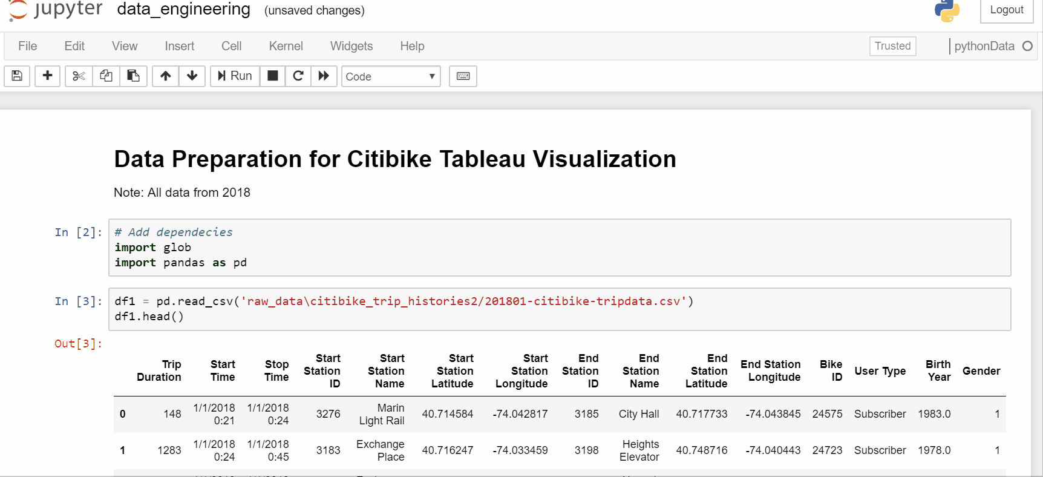
Cleaning Data

Slide 5

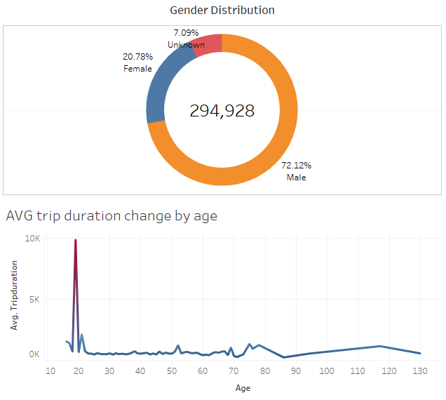
The current major citi-bike riders fall into young male group between 18 -20 but number of female raiders increases over time as they are showing interest to start riding during the weekend.

Slide 6
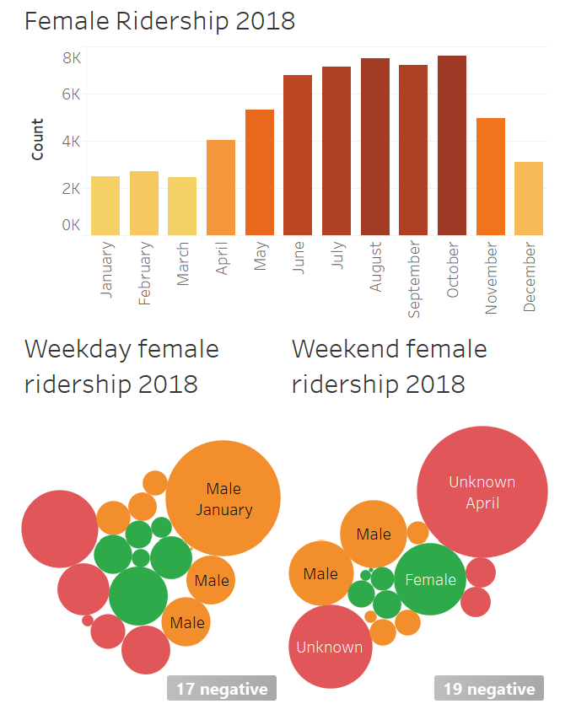
The current major citi-bike riders fall into young male group between 18 -20 but number of female raiders increases over time as they are showing interest to start riding during the weekend.

Slide 7
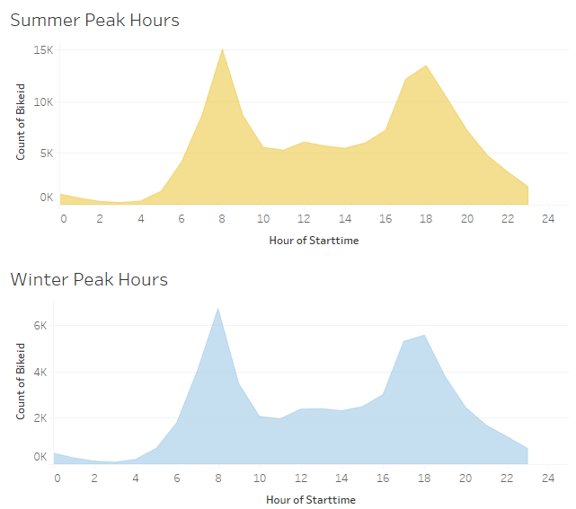
The 1st and 2nd peak hours during a day would usually be 7-8 AM and 5-6 PM season-regardless.

Slide 8
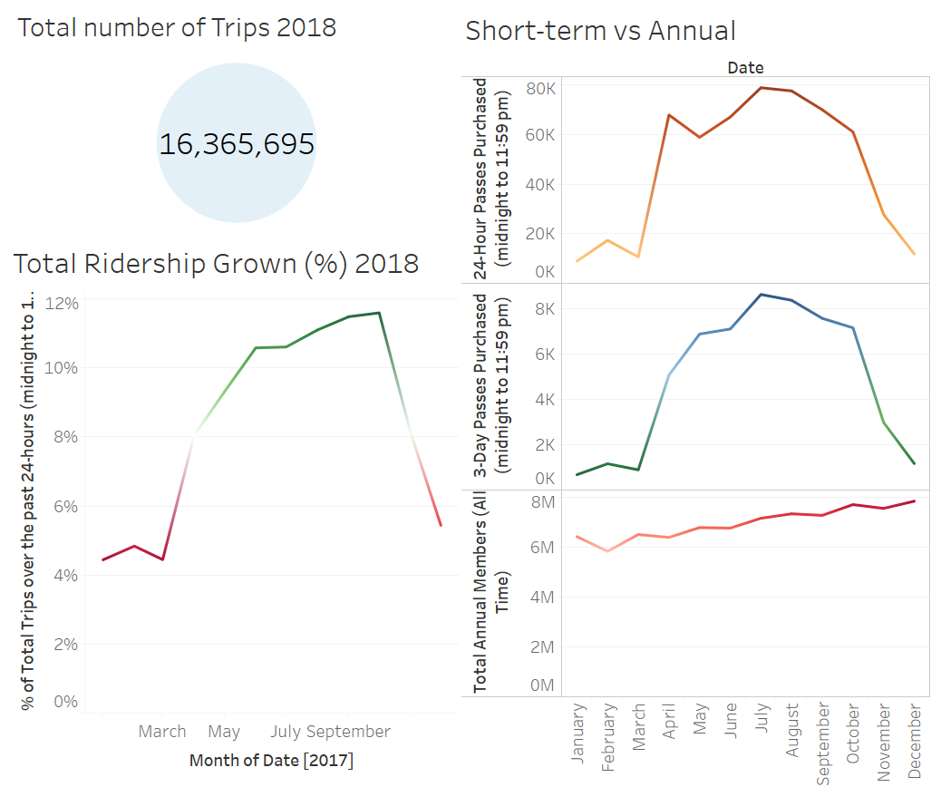
As the temperature gets cold as winter begins, people tend not to ride as well because of the lack of comfort individuals face when riding in low temperatures. Therefore, at some point the ridership does not grow. However, the total amount of annual member have been kept increased over time in 2018.

Slide 9
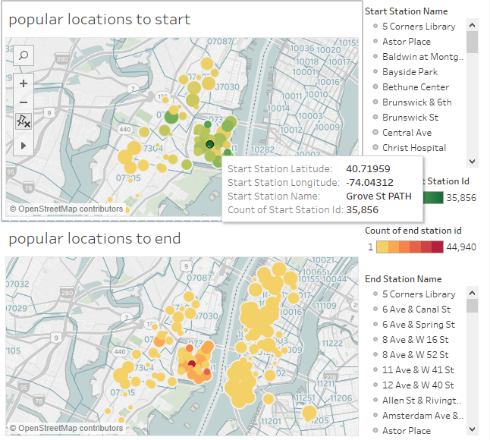
More and more people choose to live in Jersey City and work in Manhattan.

Slide 10
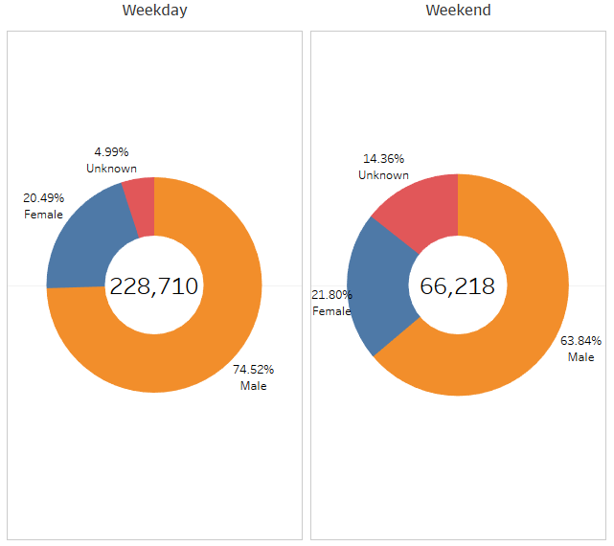
Limitation There were 7% user did not provide gender information and most of them (14%) are weekend users so we will not be able to tell if female are more willing to ride on the weekend then they do on weekdays, but we may still determine that male user are the dominant customer at all time.

Slide 11
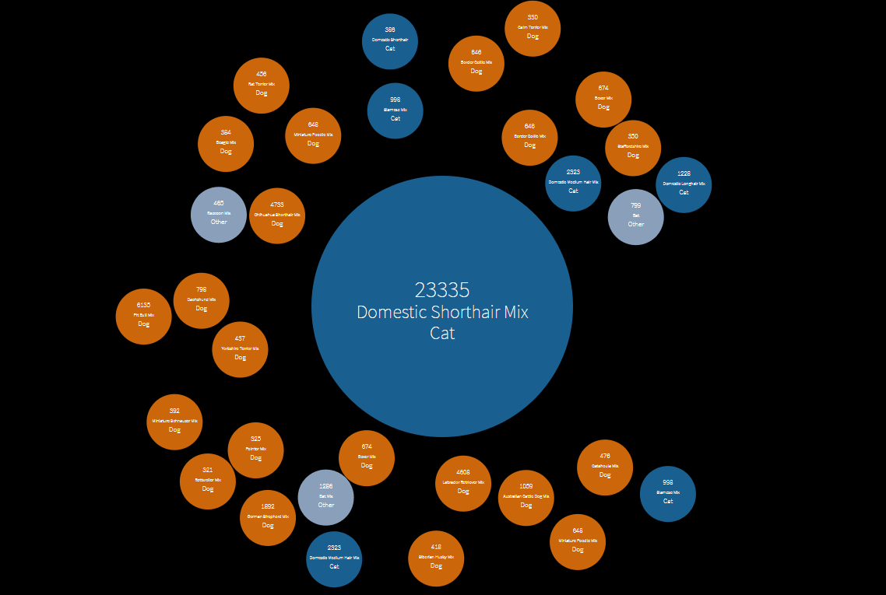
Bubble Chart
Bubbles show the most populated breeds of cats, dogs and other animals in the shelter waiting for to be adopted.

Slide 12
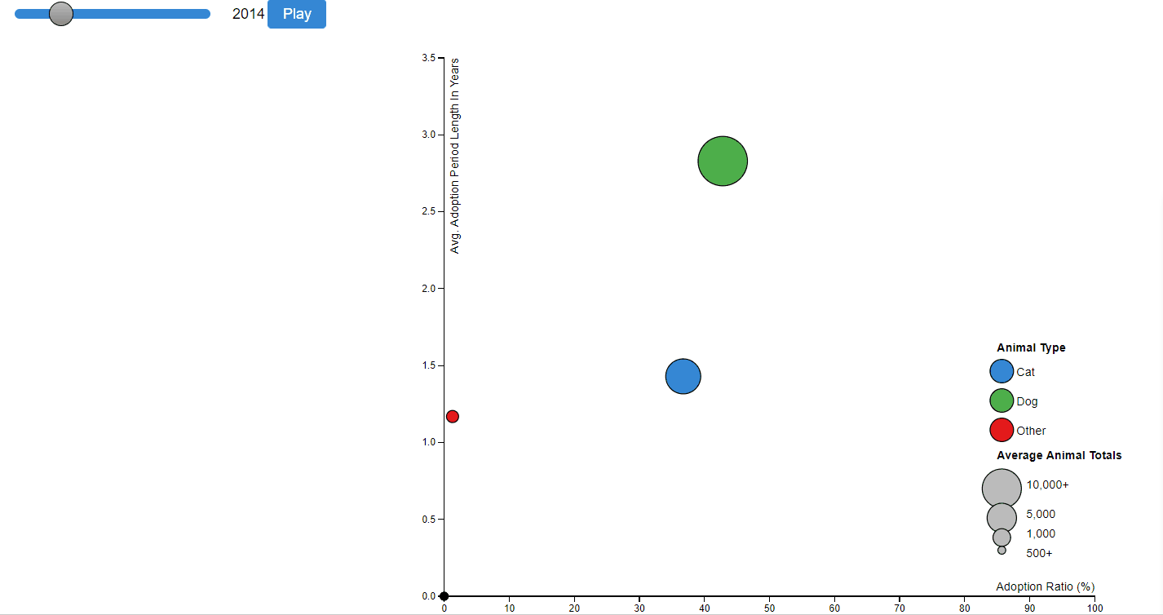
Playable Time Series Chart
Time series chart allow us to comprehend the ratio of adopted animal and how long they stayed before adopted.

Slide 13
Heroku Deployment

